Slide 1
Measuring the microbiome in industrial and academic settings
Anthony Fodor
Department of Bioinformatics and Genomics
UNC Charlotte

Slide 2
Consulting:
Salix Corporation
Second Genome

Slide 3
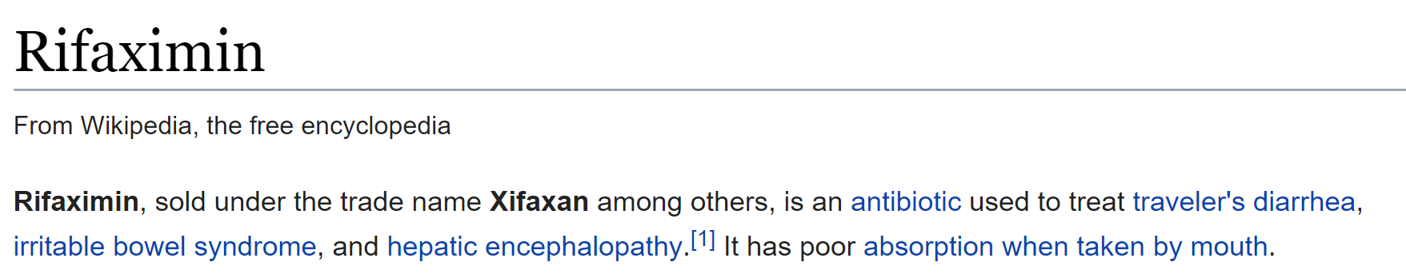
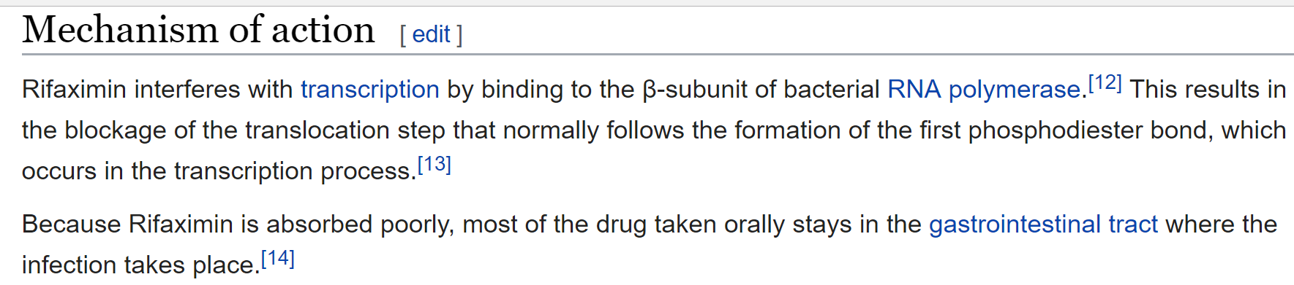
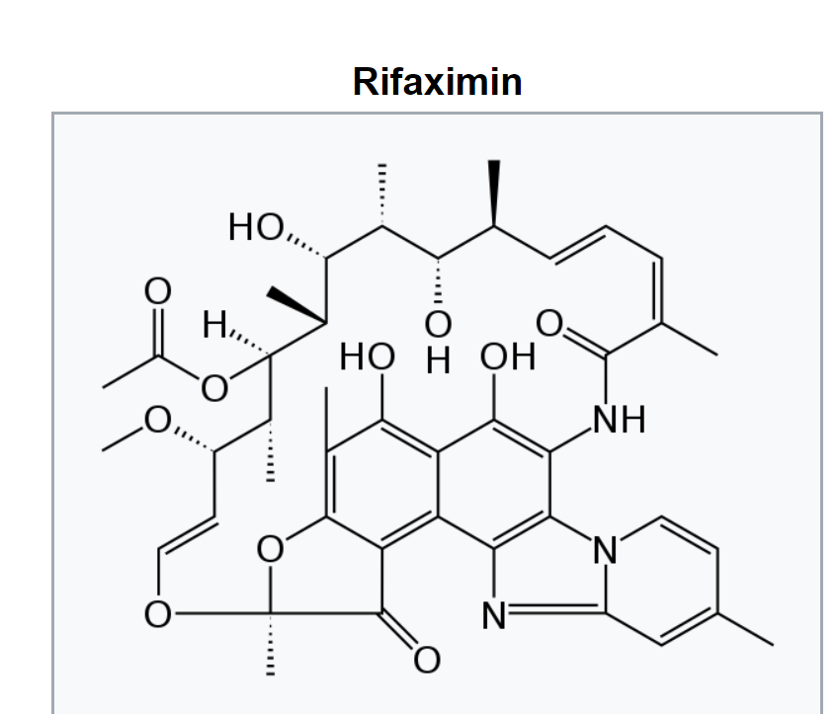

Slide 4
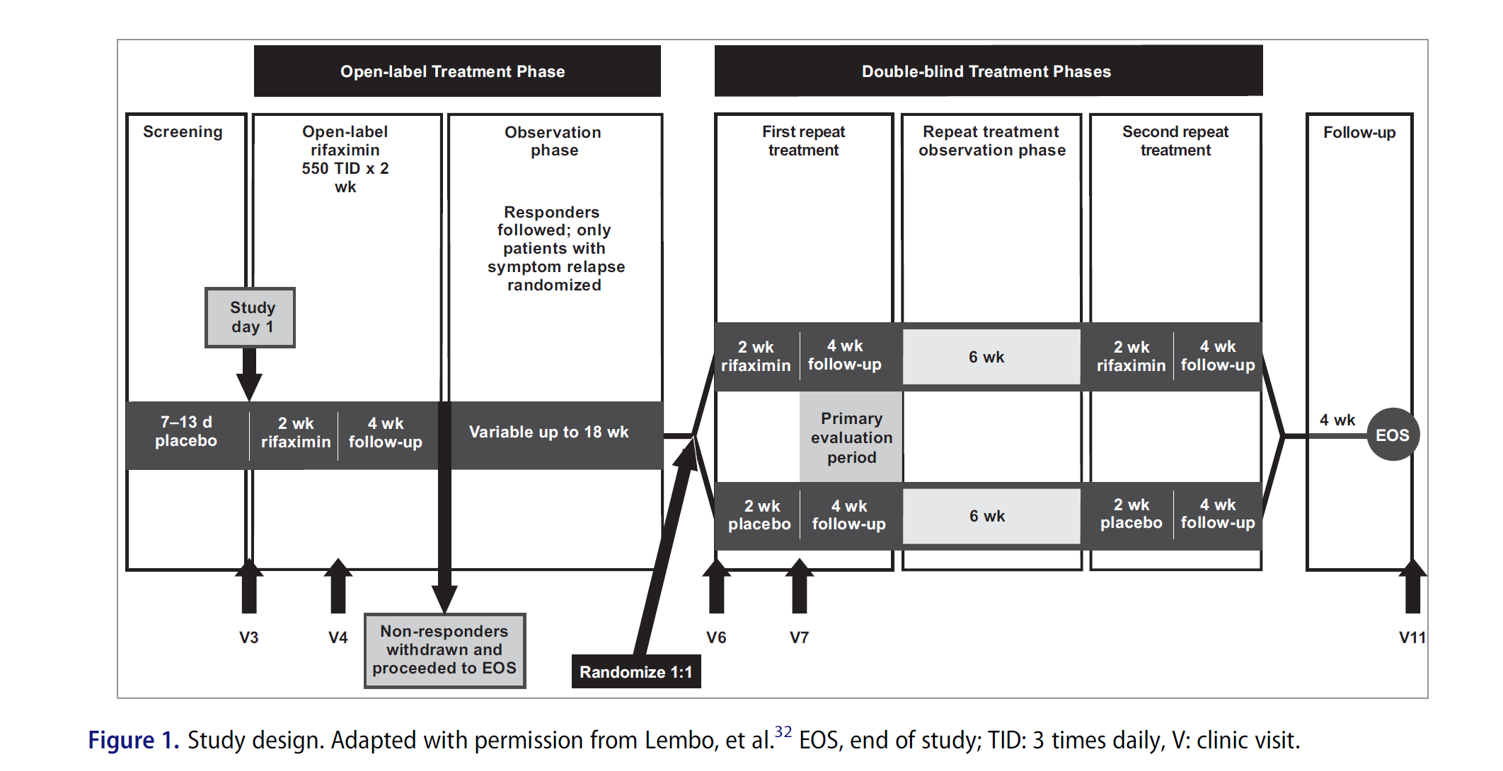
Gastroenterology 2016;151:1113–1121
CLINICAL AT

Slide 5
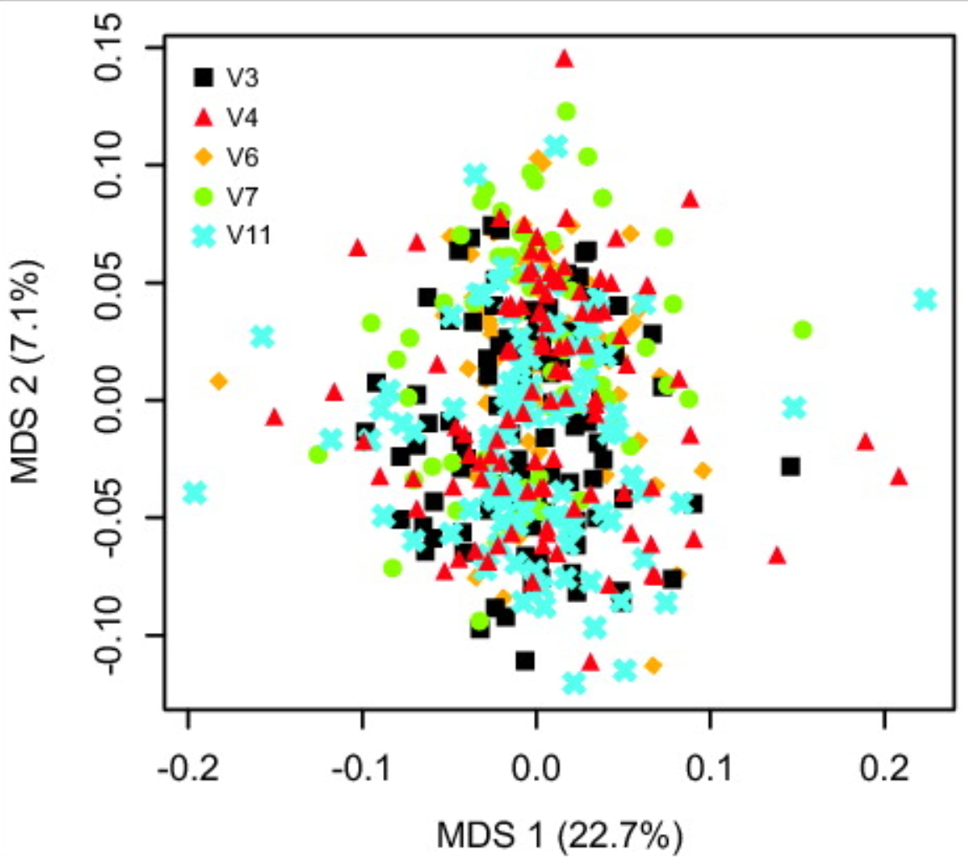
Rifaximin does not substantially re-arrange the microbial community

Slide 6
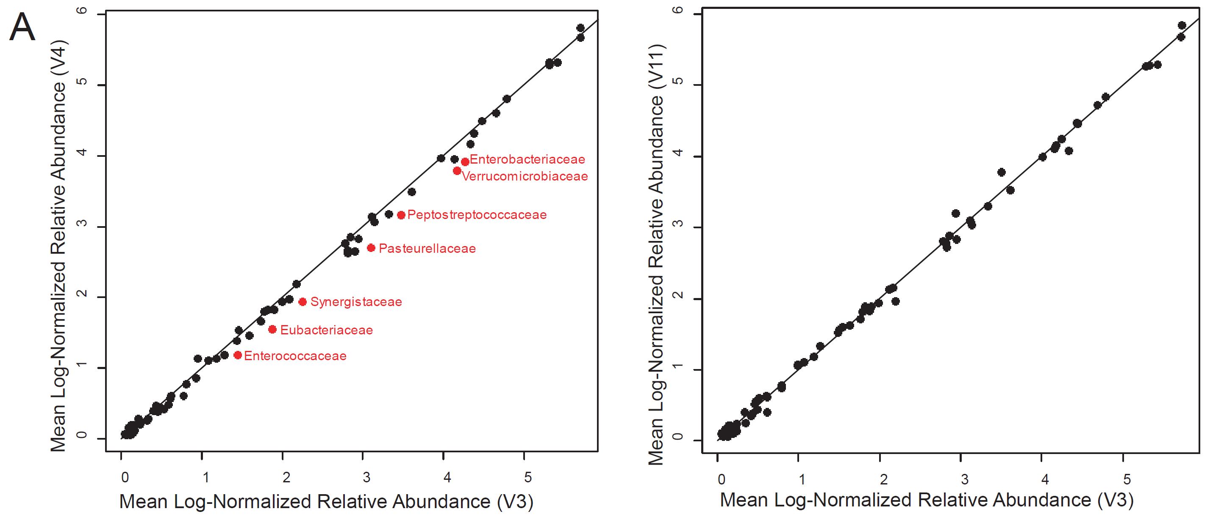
Rifaximin has modest, transient effects on multiple gut microbes

Slide 7
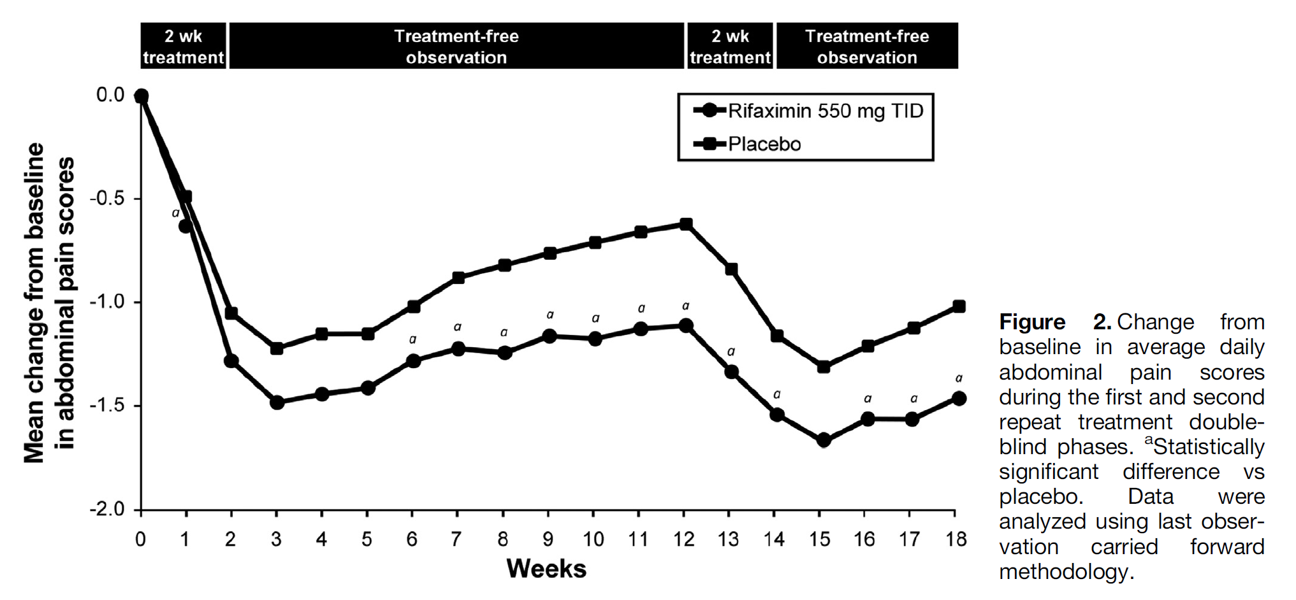
Rifaximin reduces abdominal pain scores relative to placebo
Gastroenterology 2016;151:1113–1121
CLINICAL AT
What is the impact of Rifaximin on the microbial community?

Slide 8
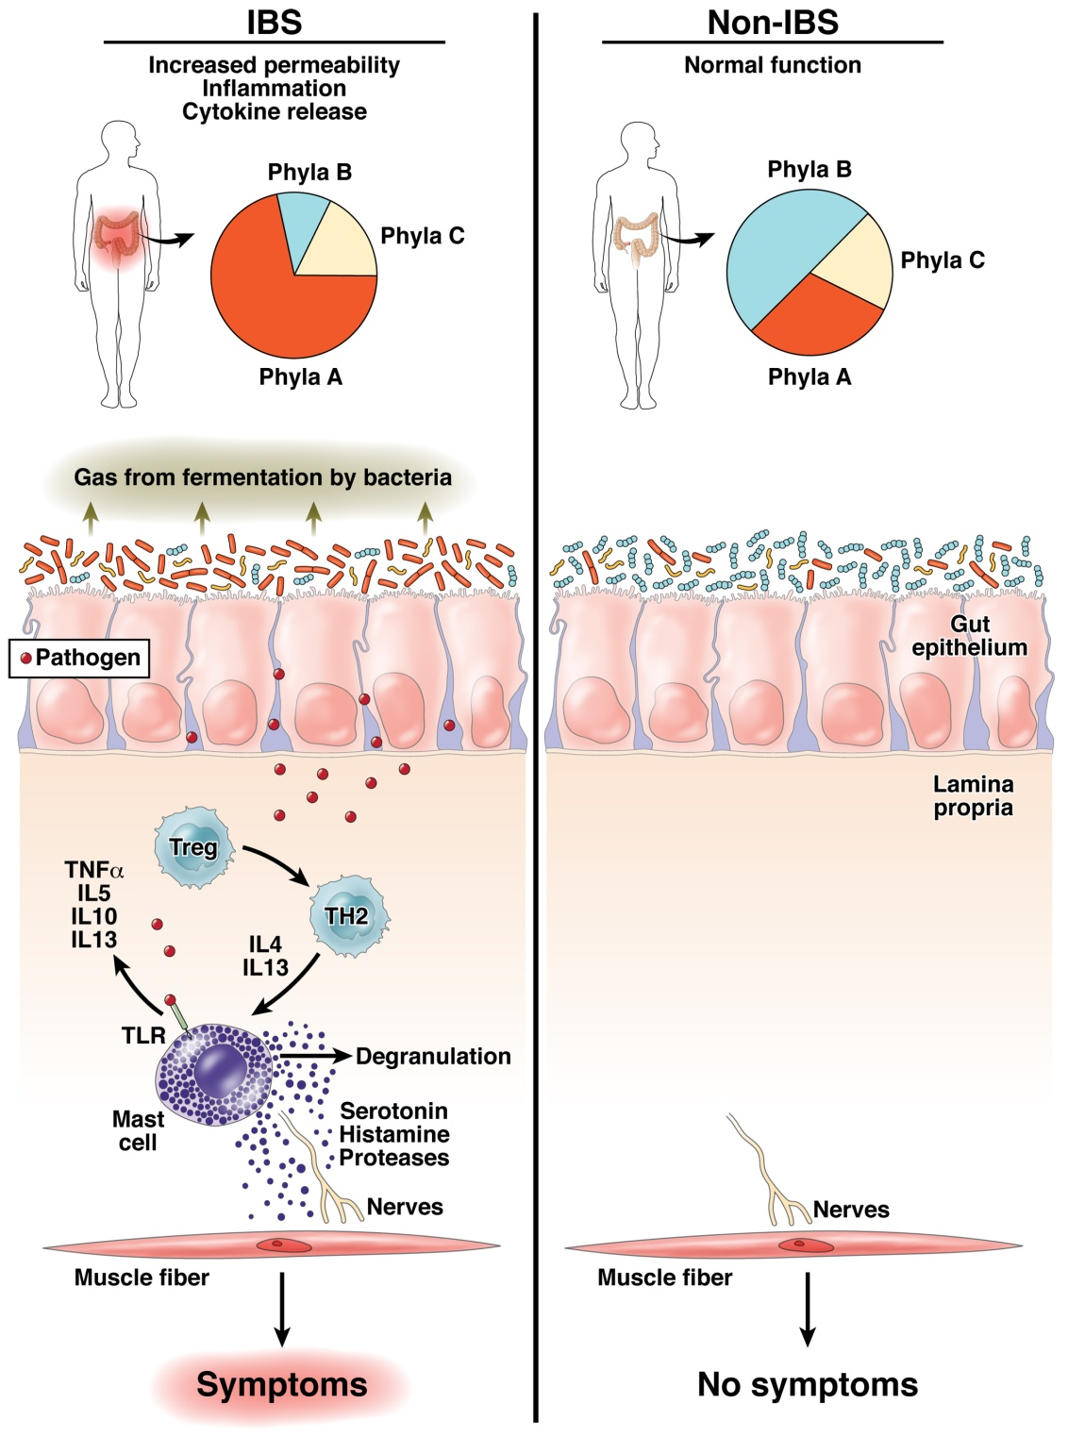
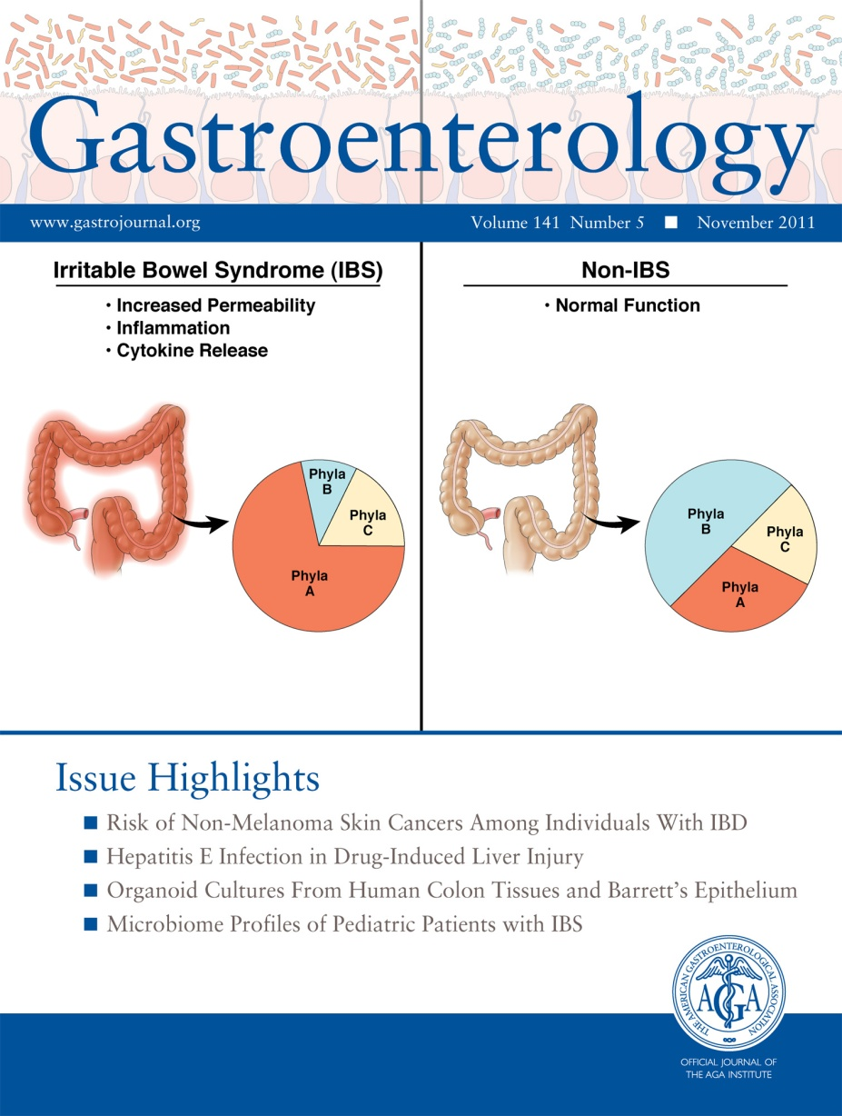
Is there a link between the action of rifaximin and the changes it produced in the microbial community?
Fodor & Talley. Gastroenterology. 2011

Slide 9
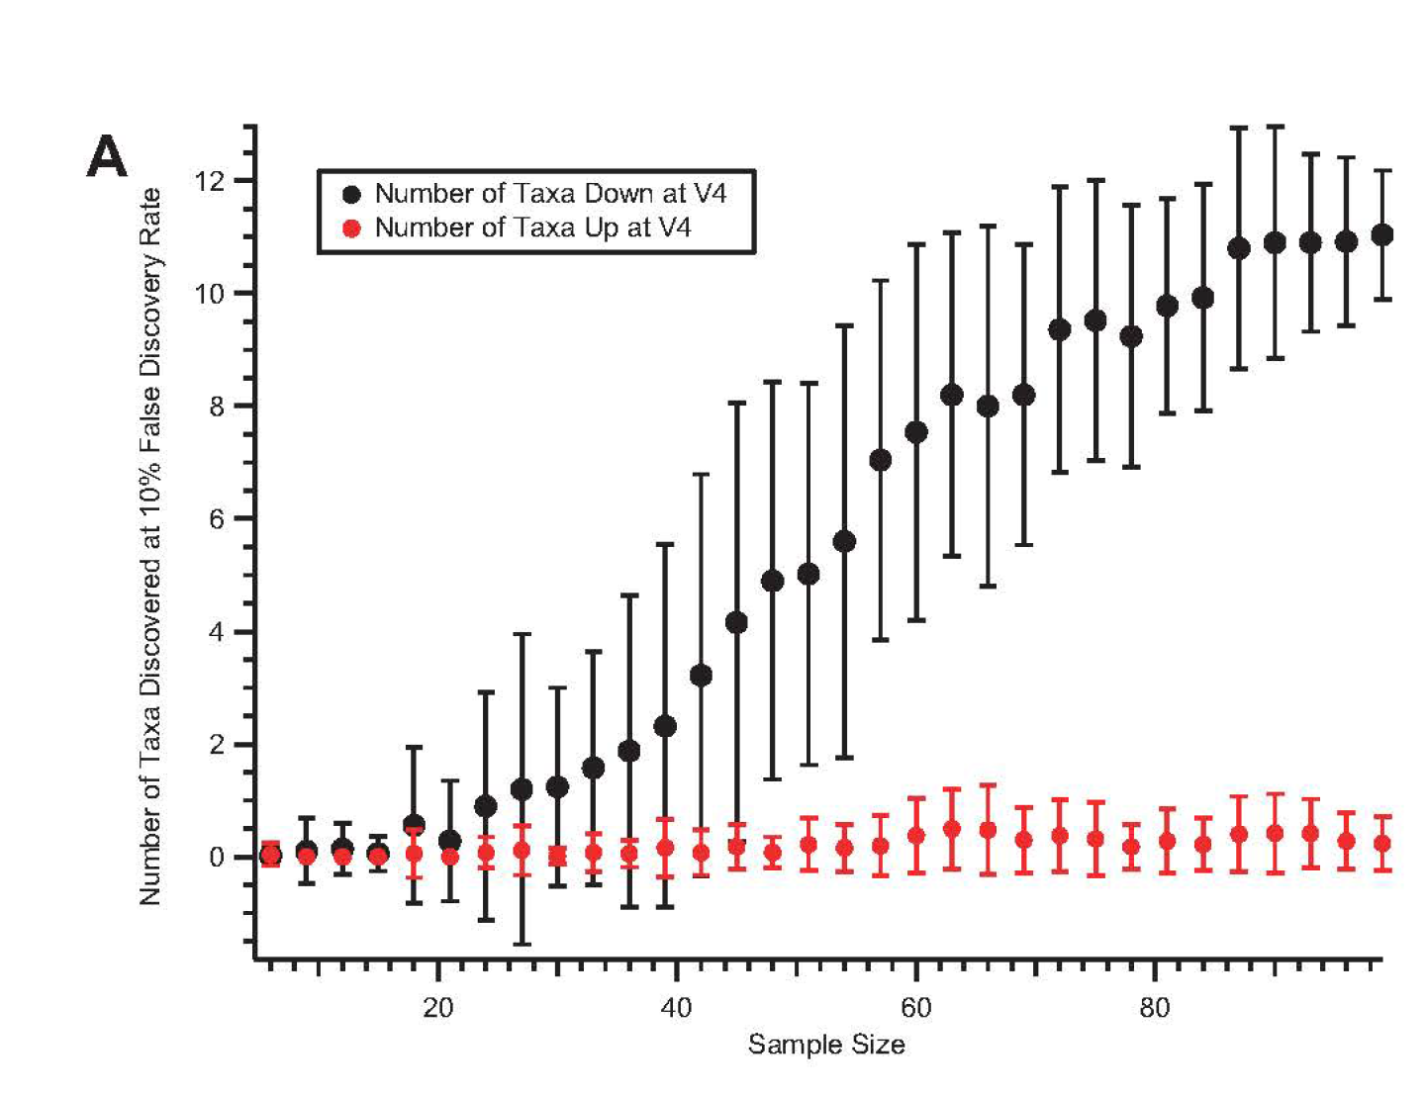
Power analyses can be used to guide future studies

Slide 10
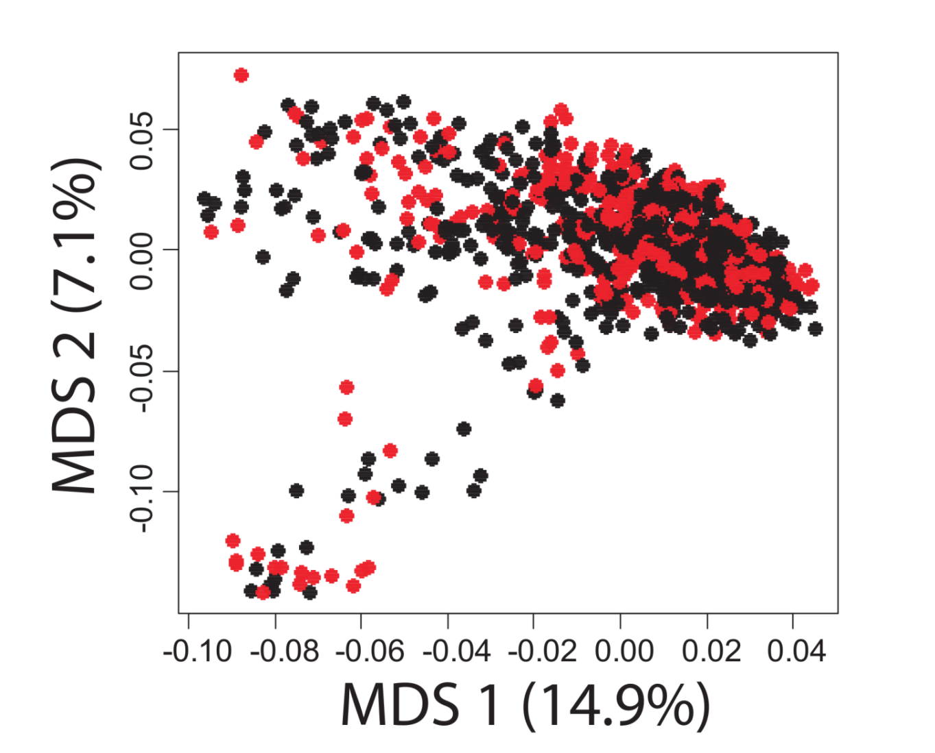
A case-control study in Colonic Diverticulosis
An Aberrant Microbiota is not Strongly Associated with Incidental Colonic Diverticulosis Roshonda B. Jones, Anthony A. Fodor, Anne F. Peery, Matthew C. B. Tsilimigras, Kathryn Winglee, Amber McCoy,Michael Sioda ,Robert S. Sandler, Temitope O. Keku2. In revision.

Slide 11
A metagenomics pipeline consists of many, sometimes difficult to justify, choices
Experimental design
Visualization and statistical analysis
Sample Size (# of cages not just # of mice)
Properly consented cohorts
Capture of confounding variables
Sufficient variation across space and time
Negative and Positive controls
Which diversity metrics?
Log-transform data?
Parametric or non-parametric tests?
Simple linear models?
Mixed models?
Zero-inflated models?
Negative-binomial based models?
Correction for multiple hypothesis testing?
Remove rare taxa?
Track sequencing depth as a confounder.
Track potential biological confounders
(e.g. cage in mouse experiments; drugs in
human surveys)
Supervised classification to build predictive
models? Cross-fold validation?
Random Forest classifiers?
Reproducibility across cohorts and datasets
generated by different labs?
Ordination?
Unifrac (weighted or un-weighted).
or PcOA? With what distance metric
(Bray-Curtis?)
Multi-page, multi-factorial visualizations?
DNA extraction
Which extraction kit/protocol?
Which sequencing platform?
Whole genome or 16S? If 16S, which primers?
sequencing
Merged paired ends? With what parameters?
Qual score filter? With what parameters?
Filter against database of known sequences? With what parameters?
Chimera check? Which algorithm? With what parameters?
Sufficient sequencing depth? Remove unique sequences?
Classification/clustering
Reference database or denovo OTUs? Or something in between?
Which algorithm (RDP, kraken, greengenes, uparse)?
What database? With what parameters?
Are the sequences microbial? From the expected tissue?
Are they just kit microbes?
Normalization
Simple proportions? Rarefication (with what depth?
single rarefication vs. average).
Balance trees? Ratio space? Geometric Mean based normalization?

Slide 12
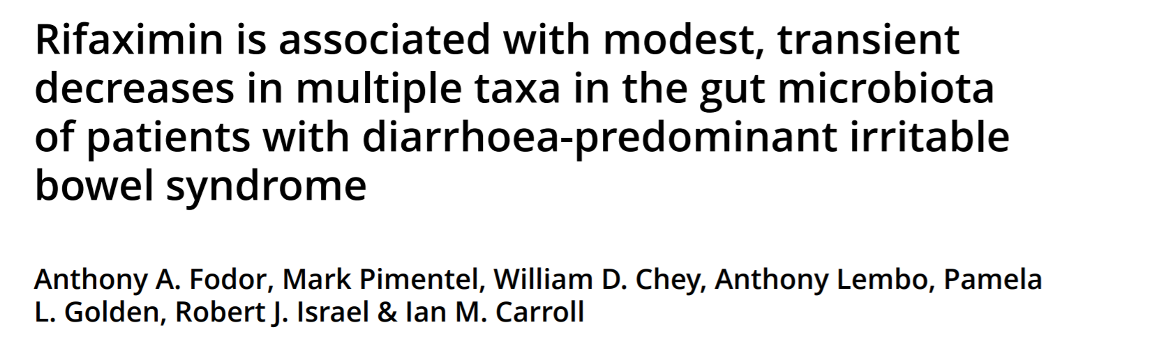

Slide 13


Our lab is hiring:
Research Assistant Professor
Post-doctoral fellows
graduate students
Contact:
afodor@uncc.edu
Image: www.tierpoint.com

Slide 14
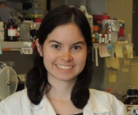











Acknowledgements
UNC-Chapel Hill
Janelle Arthur
Ian Carroll
Annie Green Howard
Marcus Muhlbauer
Penny Gordon-Larsen
Jonathan Hansen
Temitope Keku
UNC-Charlotte
Roshonda Barner
Ra’ad Gharaibeh
Cynthia Gibas
Jon McCafferty
Michael Sioda
Kathryn Winglee
Matthew Brown
UF- Gainesville
Christian Jobin
USC Vanderbilt University
Tanya L Alderete Martha J. Shrubsole
Michael Goran
Emily Noble
Scott Kanoski
Kathryn Winglee
Annie Green Howard
Penny Gordon-Larsen
Raad Gharaibeh
Jon McCafferty
Marcus Muhlbauer
Janelle Arthur
Christian Jobin

Slide 16
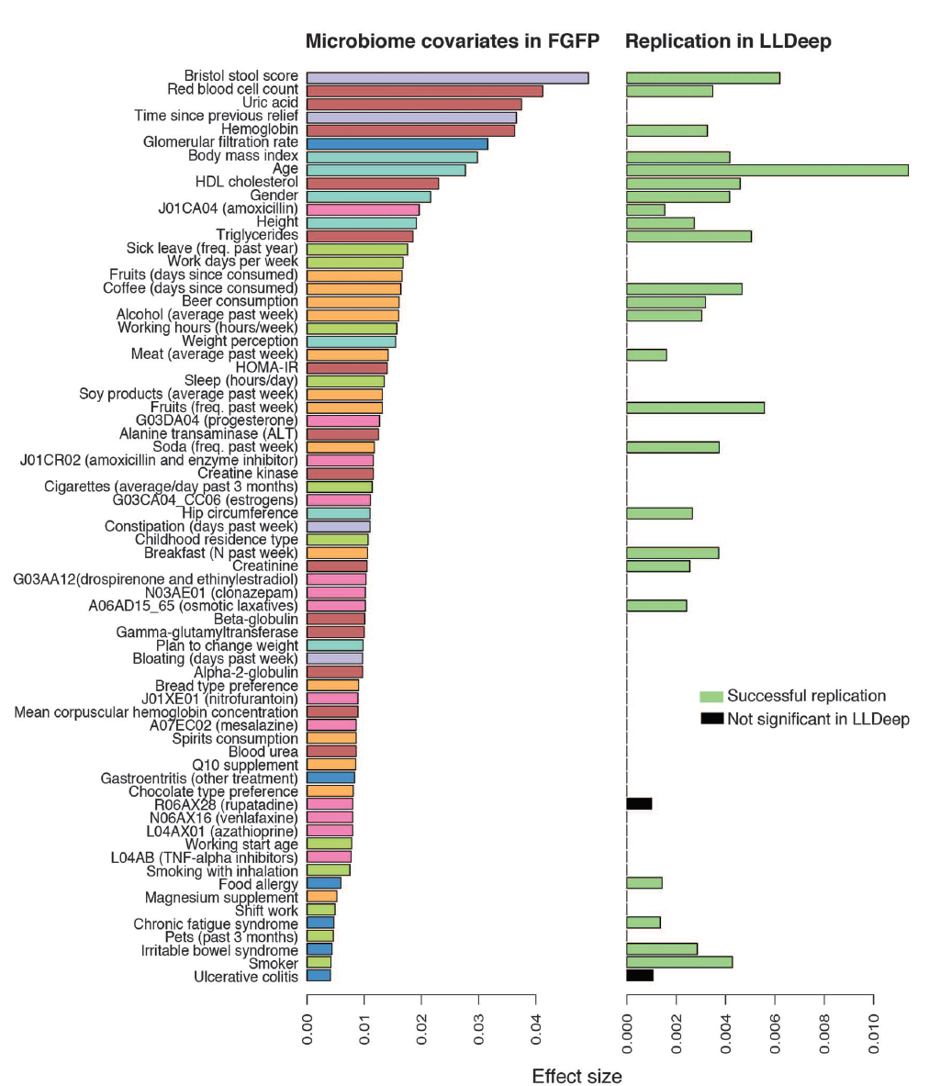
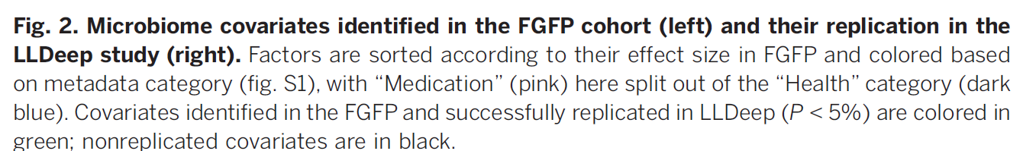
Microbial community composition and gene content is poorly associated with healthy variation
Initial analysis: 503 metadata variables
69 significant at 10% FDR
26 have analog in replication cohort
24 of these are significant
(but effect sizes in replicate cohort drop to << .01)
Power estimates suggests > 1600 subjects
needed to power BMI study…
Gwen Falony et al. Population-level analysis of gut microbiome variation -Science 29 Apr 2016

Slide 17
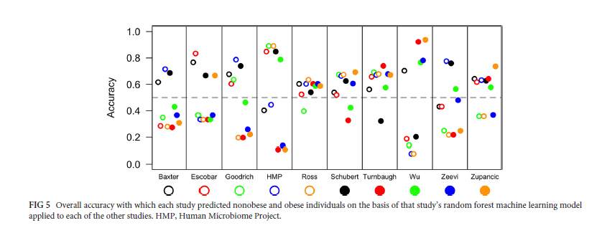
Replicability across studies appears especially poor
Sze and Schloss - Looking for a Signal in the Noise: Revisiting Obesity and the Microbiome– mbio, 2016

Slide 18
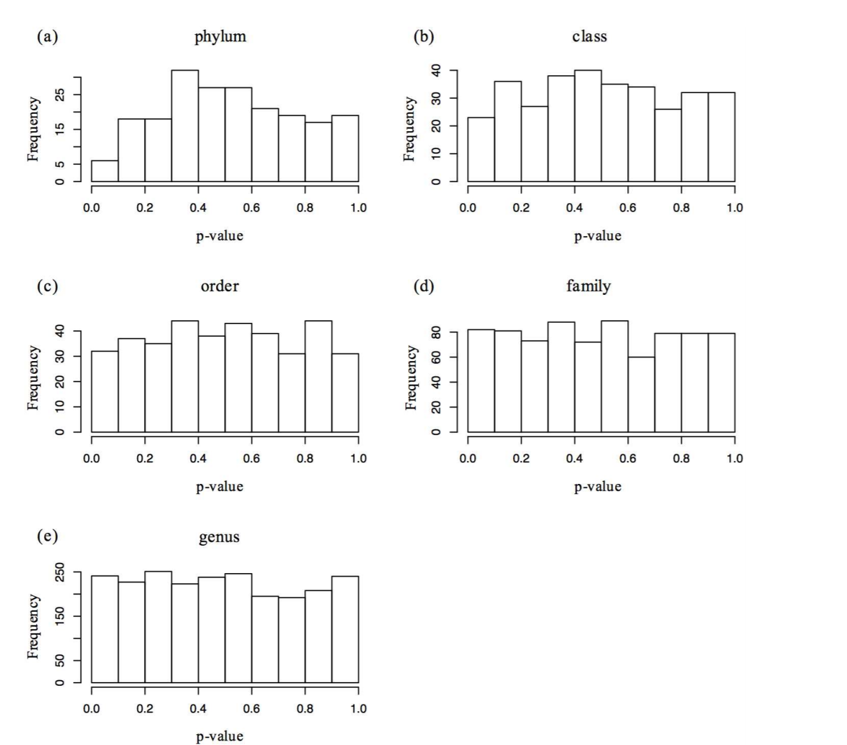
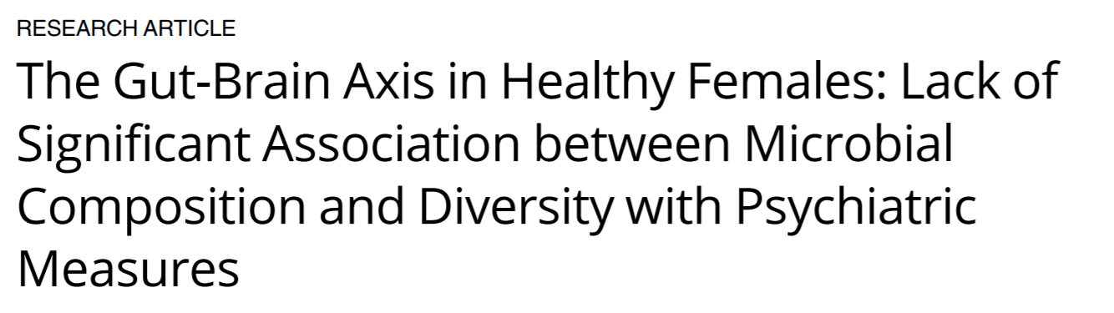
Small effect sizes are hard to tell from negative results at reasonable sample sizes…

Slide 19
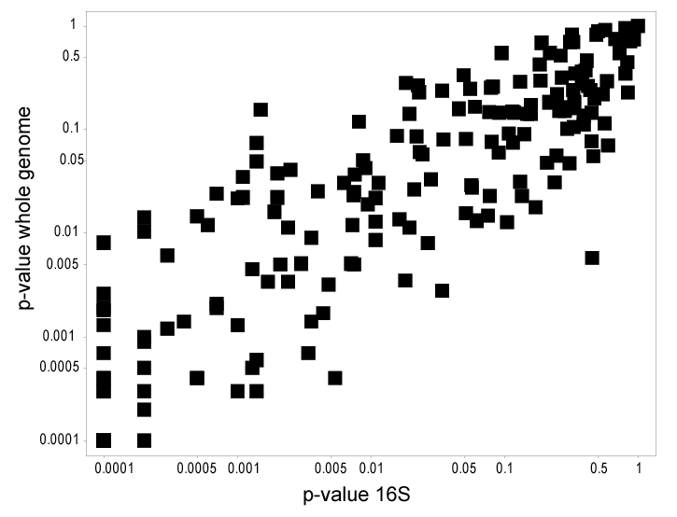
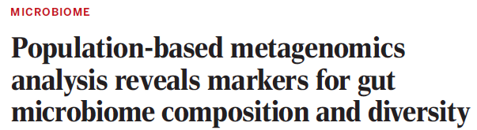
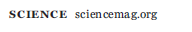
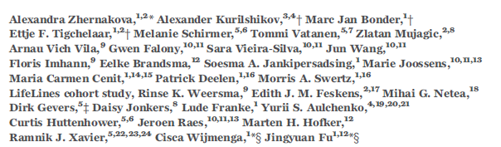
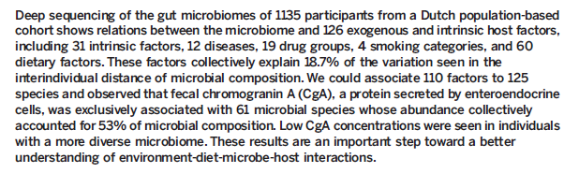
Within a pipeline, inference performed on WGS and 16S can produce very similar results
Supplementary table 7

Slide 20
A case-control study in Colonic Diverticulosis
An Aberrant Microbiota is not Strongly Associated with Incidental Colonic Diverticulosis Roshonda B. Jones, Anthony A. Fodor, Anne F. Peery, Matthew C. B. Tsilimigras, Kathryn Winglee, Amber McCoy,Michael Sioda ,Robert S. Sandler, Temitope O. Keku2. In revision.

Slide 21
How reliable are our measurements?

Slide 22
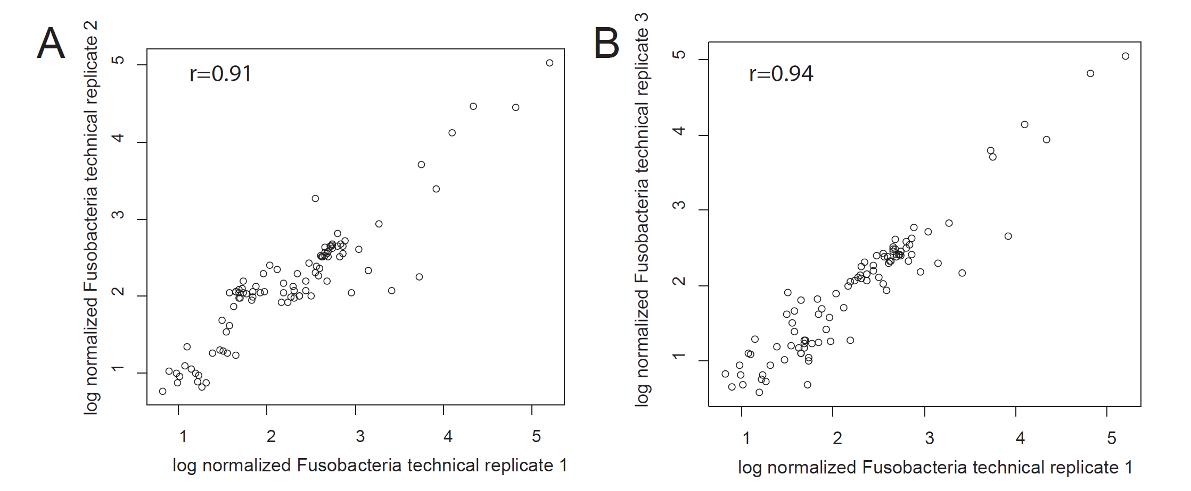
Within a pipeline, PCR and extraction steps can be highly replicable
Rifaximin Treatment is Associated With Small, Transient Decreases in Multiple Taxa in the Human Gut Microbial Community. Fodor et al. In press, Gut Microbes

Slide 23
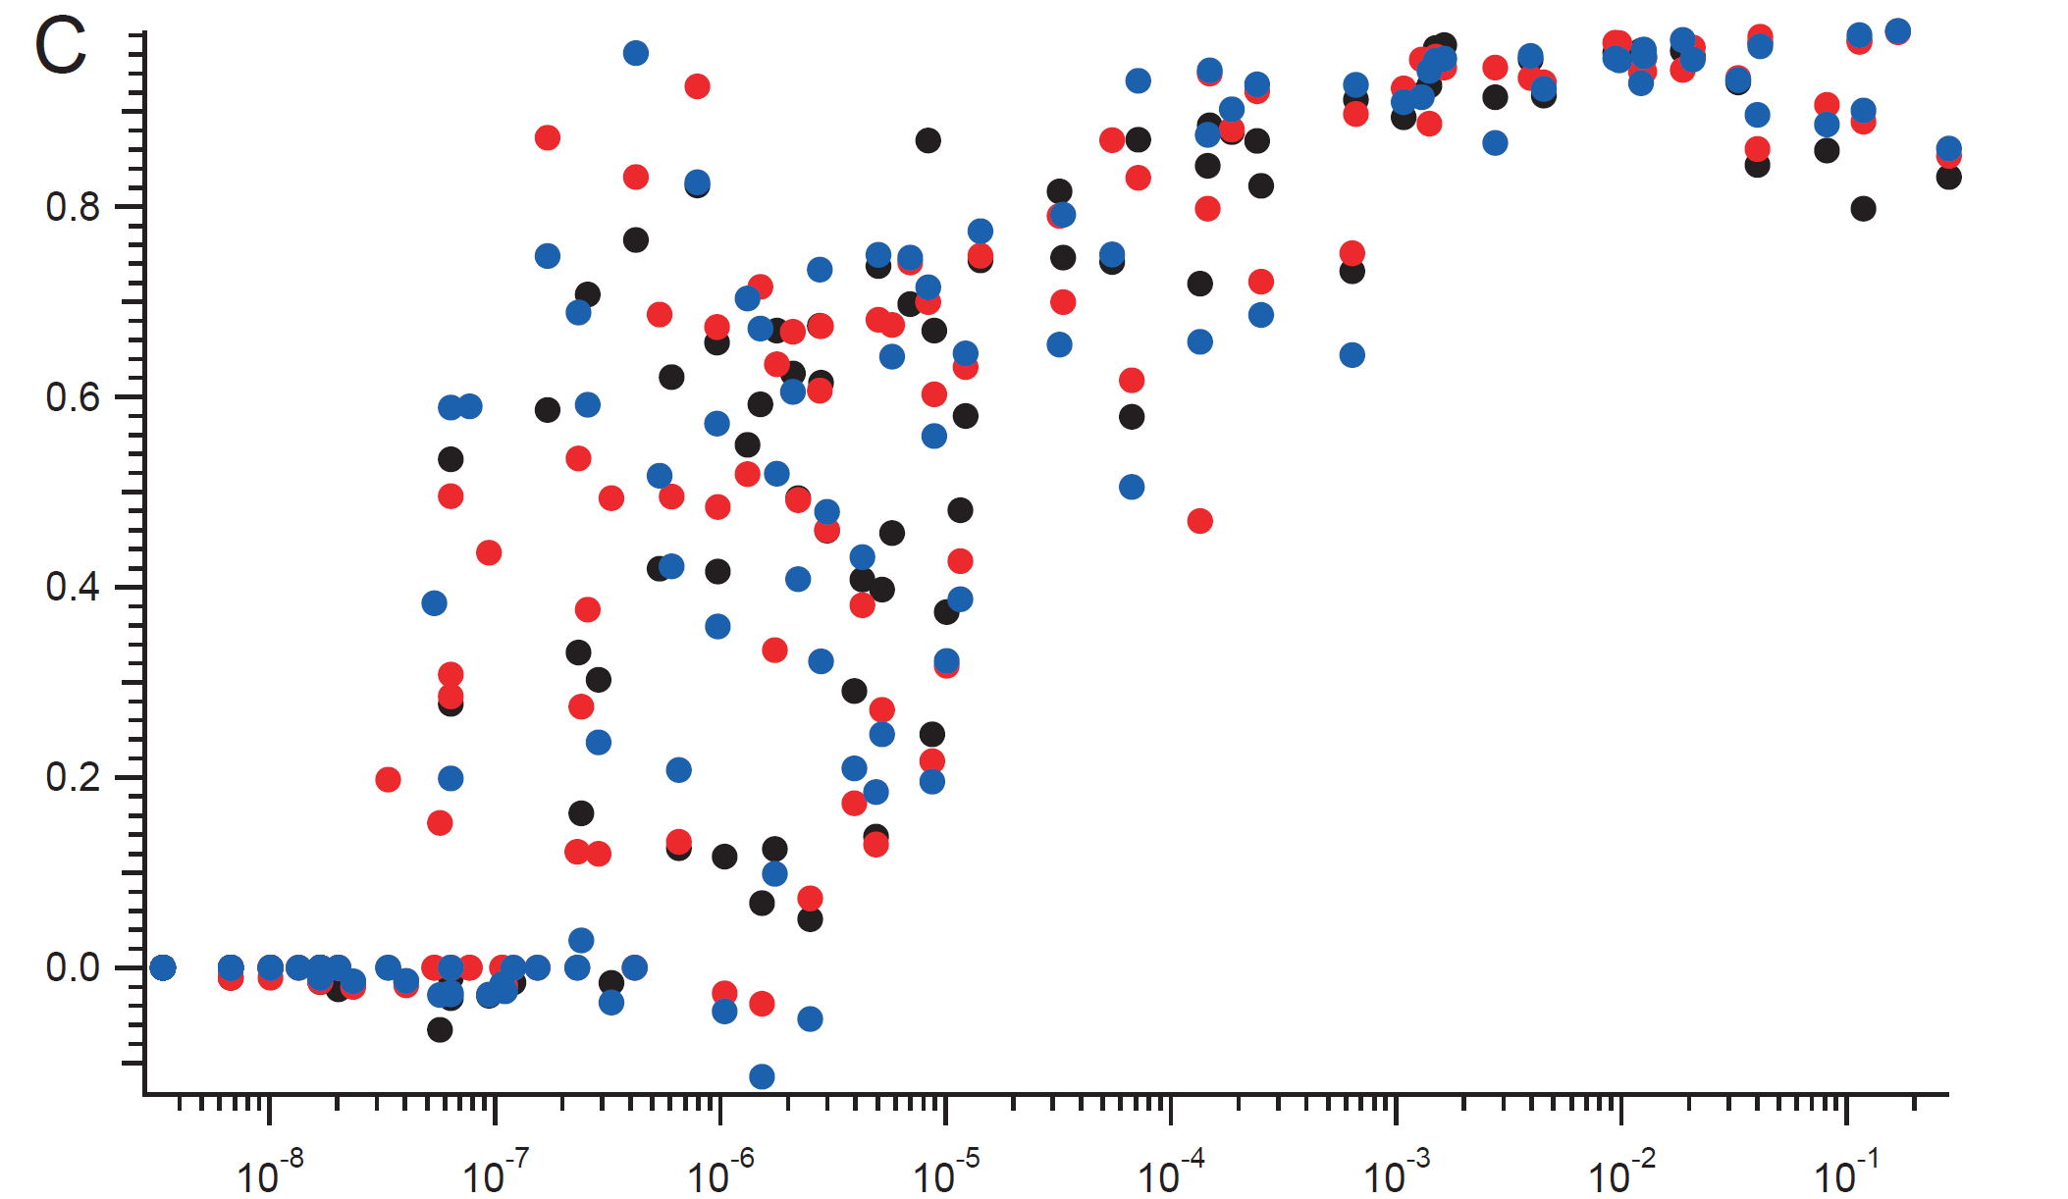
Within a batch, reproducibility can be very high for non-rare taxa
.8
Correlation Coefficient
.6
.4
.2
.0
10⁻⁸
10⁻⁷
10⁻⁶
10⁻⁵
10⁻⁴
10⁻³
10⁻²
10⁻¹
Relative Abundance

Slide 24
Every analysis can be a meta-analysis

Slide 25
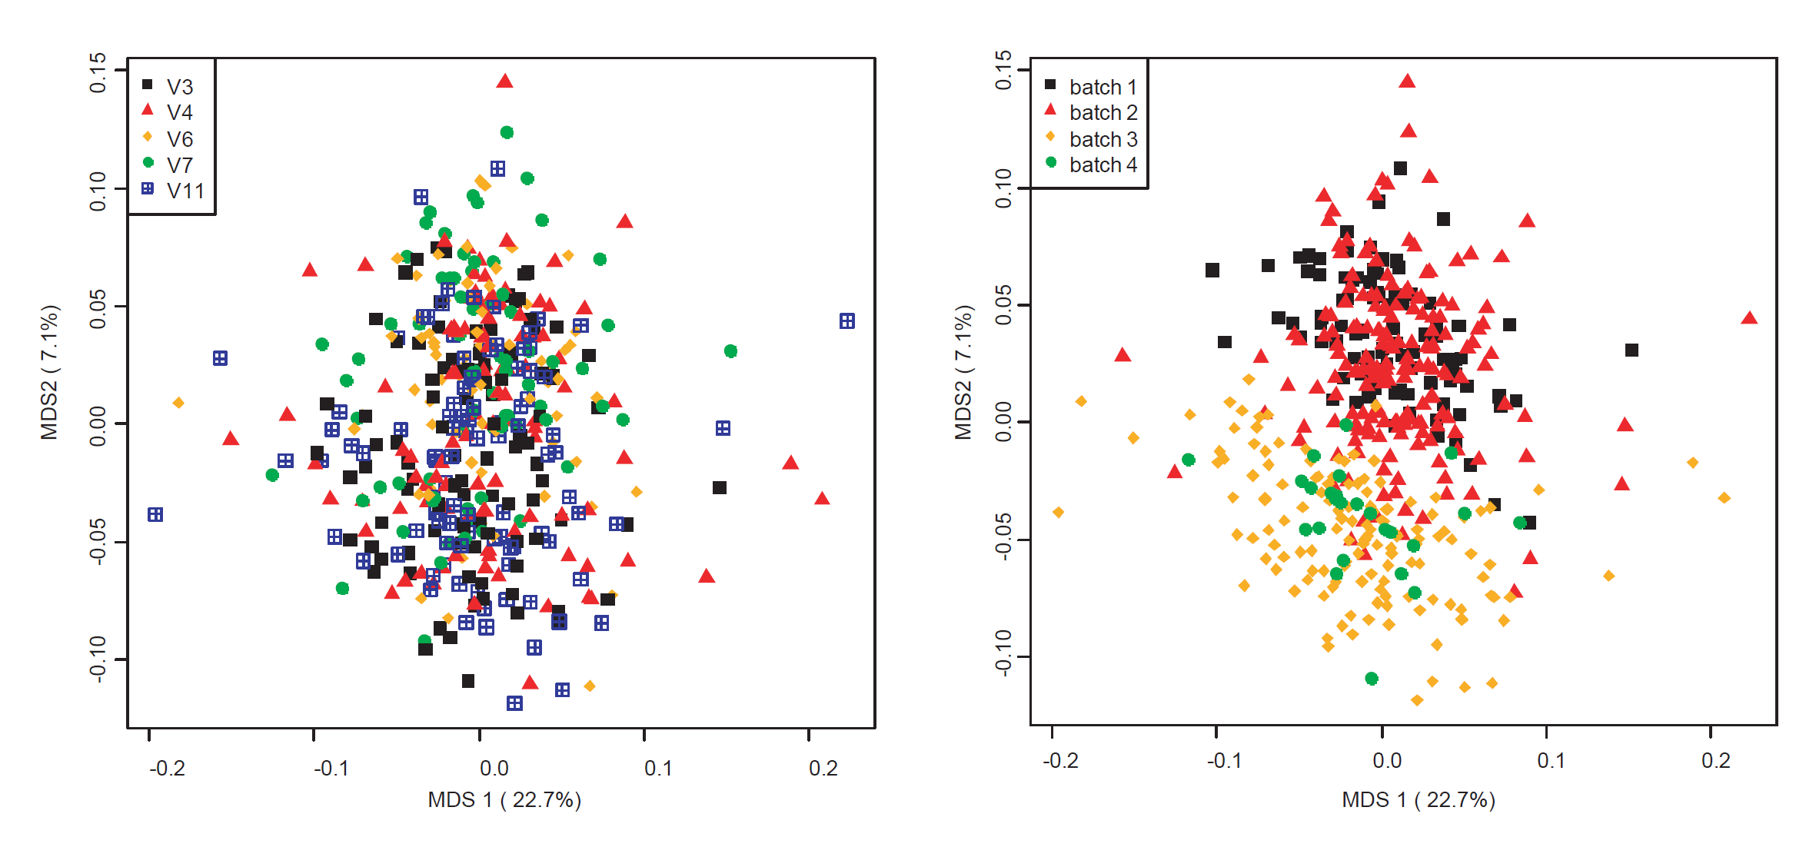
Batch effects can be pronounced in microbiome studies
Rifaximin Treatment is Associated With Small, Transient Decreases in Multiple Taxa in the Human Gut Microbial Community. Fodor et al. In press, Gut Microbes

Slide 26
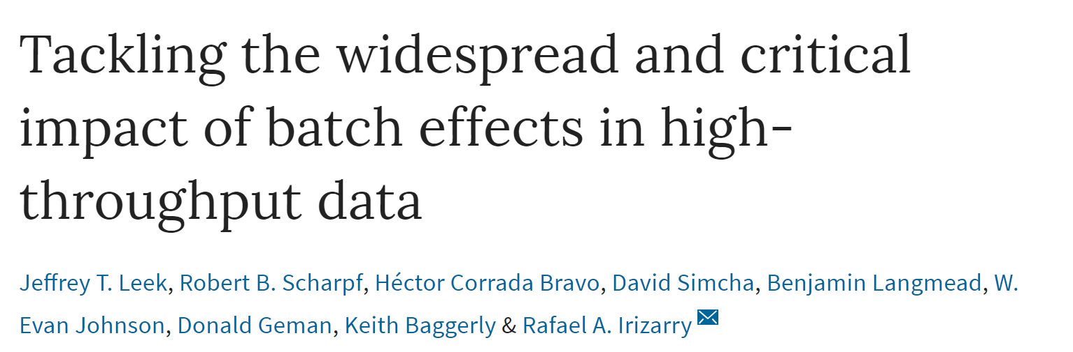
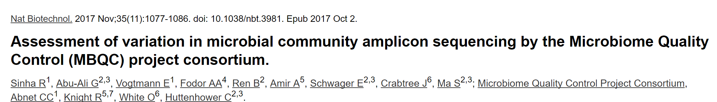

Slide 27
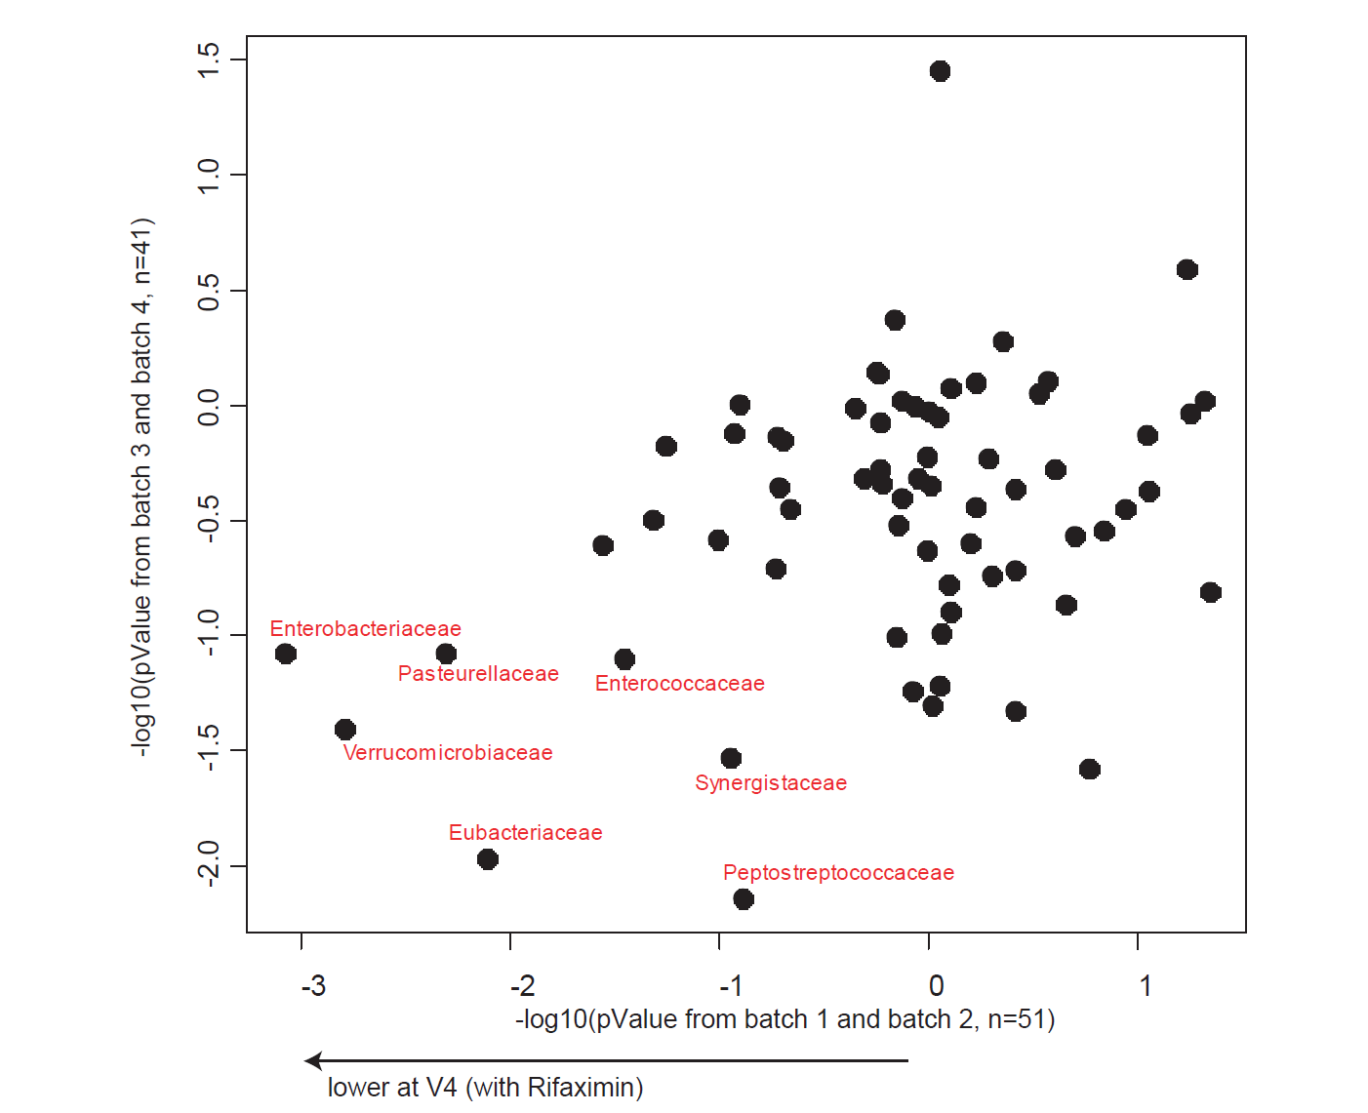
Inference can (hopefully) survive across batch effects

